Slide 1






Senior Cycle Subject Options
January 2024

Slide 2
How do I choose the subjects that suit me?
Firstly, look at your Junior Cycle results/class tests and find the subjects in which you perform(ed) well. Choosing subjects that you are best at will benefit you in attempting to gain the highest grade possible in it in the Leaving Cert.
You should consider the subjects you enjoyed most during the Junior Cert cycle. Taking an interest in a subject will greatly help to motivate you when it comes to studying and allows the information to stick in your mind more easily.
Remember the vast majority of courses on offer through the CAO are based on points and points only so it is important that you maximise your chances of achieving these by choosing your leaving cert subjects wisely.
Make sure to include any subjects you might need for third level (either those specifically required for the course or those that might benefit your studies for that course e.g. Business/Accountancy for Commerce etc.

Slide 3
Consider the Practical Element
Art 62% practical 38% final exam
Construction 25% practical 25% project 50% final exam
DCG 40% practical 60% final exam
Geography 20% fieldtrip 80% final exam
Engineering 50% practical 50% final exam
History 20% project 80% final exam
Home Economics 20% project 80% final exam
LCPE 30% Practical Performance 20% Physical Activity Project 50% Written Exam
Computer Science 30% project 70% final exam

Slide 4
Your Skills and Talents
Creative skills– you enjoy reading, creative writing, story-telling etc.
  English, History
Mathematical Skills– you are good at logical thinking, numbers and figures
  Higher Level Maths
  Physics
  Accounting
Scientific Skills– you enjoy collecting and analysing information and are good at memorising
  Chemistry
  Biology
  Physics
  Agricultural Science
  Geography

Slide 5
Practical Skills– you enjoy making things, doing things and knowing how things work
  Engineering
  Construction Studies
  Home Economics
  Design and Communication Graphics (DCG)
  Computer Science
Social Interests–you enjoy learning about society (past and present) and the world around you
  History
  Geography
  Political Studies
Business Skills–you enjoy learning about the business world and everything to do with it:
  Business
  Accounting
  Economics
Artistic skills– you are talented and gifted in the arts and enjoy using your creativity
  Art
  Music

Slide 6
COMPUTER SCIENCE
Subject Content
Study of computers and computer programming
  How programming and computational thinking can be applied to the solutions of problems, and how computing technology impacts the world around us.
Strand 1: Practices and principals – think like a computer scientist – Design Process, Computers and Society, Ethics & Computers, Computational Thinking
Strand 2: Core Concepts – Abstraction, Algorithms, Data, Computer Systems, Evaluation/Testing
Strand 3: Computer Science in practice – Complete 4 Applied Learning Tasks – project work preparing for final year project
Languages currently being studied/examined: Python, HTML/CSS & Javascript

Slide 7
Exam Structure
70% End of Course Examination – Assessed at both Higher and Ordinary Level.
Exam takes place in May:
  Written Exam - Section A & B - 1½ hours - 60% - 10 short & 2 long questions
  Break – ½ hour
  Computer Based - Section C - 1 hour - 40%
30% Coursework Assessment – In 6th year, after Christmas, design brief set to generate a computational artefact & report in response to a brief set out by the SEC.
2023 – 24% received H1 grade, 22% received H2, 18% received H3 – 1,986/230 students
2022 – 19% received H1 grade, 21% received H2, 20% received H3 – 1,382/222 students

Slide 8
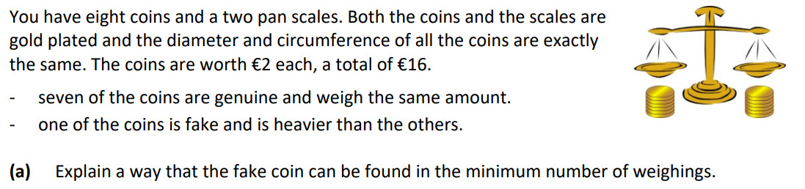
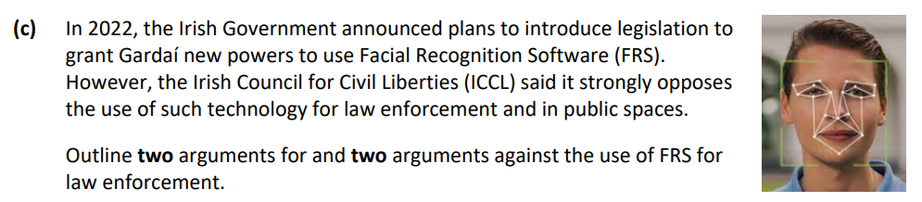
Past Question 1
Past Question 2

Slide 9
Basic Requirements
A strong knowledge of and interest in ICT skills
Students who enjoy creating applications with computers
Students who think logically and have an aptitude for maths & science
Students who enjoy puzzling out and solving problems
Students must be hard-working, disciplined, motivated, well organised and persistent
Previous knowledge of computer programming would be of benefit, but is not a requirement
Access to a laptop/computer at home would be very helpful but is not a requirement

Slide 10
Career prospects
Working in Computing and ICT
  Software Development & Programming
  Designing video games
  Cloud Computing
  Working with Big Data – monitoring online activities & trends
  Manufacturing Hardware
  AI
Statistician/Actuary
Data Analytics
Engineering
Skills are very transferable to a much broader range of career paths, the problem solving, logical thinking and programming skills developed in the course will be of value in many workplaces and activities.

Slide 11
Accounting
Subject Content
Students of accounting will be able to complete and understand:
Company Final Accounts incl. manufacturing account
Published Accounts
Control Accounts – Creditors & Debtors
Revaluation/Depreciation of Fixed Assets
Tabular Statement
Correction of Errors & Suspense Accounts
Budgeting
Club Accounts
Service Firm Accounts
Farm Accounts
Cash Flow Statements
Job Costing
Production Budgeting
Interpretation/Analysis of Accounts

Slide 12
Exam Structure
3 hour exam
400 marks
3 Sections:
  Section 1: Financial Accounting – 30% of overall exam
  Section 2: Financial Accounting – 50% of overall exam
  Section 3: Management Accounting – 20% of overall exam
Basic Requirements
Accounting is a subject that suits the organized, methodical person who likes definite answers.
There are no prerequisites for the study of accounting - just an interest in working with figures. It is an advantage but not essential to have studied Business Studies at Junior Cert.
The course is numerically based but theory and procedures must be learned also.
While the student needs to be comfortable with numbers he or she does not need to be at higher maths level.
This course offers a hard working student the real possibility of high grades because of the unambiguous nature of the questions. An organised student who likes order will be particularly suited to this course.

Slide 13
For those considering studying accounting, actuarial studies [analysing the financial consequences of risk] or finance after the Leaving Cert it would be unwise to leave accounting out of their subject choice. It is also be an important subject choice for those thinking of starting their own business.
While not required specifically for studying any third level college course, it is recommended if Accountancy is the career path you want to follow.
Career prospects
Accountancy & Taxation
Sales, Retail & Purchasing
Banking & Financial Services
Business Management

Slide 14
AGRICULTURAL SCIENCE
Subject Content
Unit 1: Soils – Chemical and Physical Properties, Management, Formation and Classification
Unit 2: Animals – Physiology, Systems, Management and Husbandry
Unit 3: Crops – Plant Physiology, Classification and Identification, Establishment, Management and Harvesting
22 Practical Activities
Exam Structure
Exam worth 75% of final grade
Section A: Answer 10 short questions
Section B: Answer 4 long questions
Coursework worth 25% of final grade - Individual Investigative Study
Thematic Topic Set by State Exam Commission – collect and process data, evaluate evidence and develop arguments.

Slide 15
Basic Requirements
Some experience of farming is beneficial.
Very science heavy course – Students should have a good understanding of Junior Cycle Science
Each student must have an aptitude for and interest in laboratory work.
A considerable amount of learning and study is necessary to do well in this subject
Overlapping content with both Biology and Geography.
Career prospects
Farming, Horticulture and Forestry
Biological, Chemical and Pharmaceutical Sciences
Engineering, Manufacturing and Energy
Animals and Veterinary Science
Earth and Environment
Biomedical Technologies and Medtech

Slide 16
APPLIED MATHS
Subject Content
Exam Structure
Units and Vectors
Uniform Acceleration
Projectiles
Newton’s Laws and Connected Particles
Work, Power, Energy and Momentum
Impacts and Collisions
Motion in a Circle
Difference Equations
Differential Equations
Networks and Graphs
Optimal Paths
2.5 Hour Exam (80%)
Mathematical Modelling Project (20%)
Previous projects include:
Projectile motion in a sport (2023)
Model an aspect of roller coaster motion (2024)

Slide 17
APPLIED MATHS
BASIC REQUIREMENTS
Higher Level Maths would be important.
This would suit a problem solving and methodical person.
There is quite a big overlap between Applied Maths, Physics, and Higher Level Maths.
The ability to Mathematically model, which is the process of using mathematics to represent, analyse, make predictions and provide insight into real-world phenomena.
Career Prospects
Used in a variety of disciplines such as:
Theoretical Physics
Bioinformatics
Robotics
Image Processing
Chemistry
Economics
Engineering
Finance

Slide 18
BIOLOGY
Subject Content
Unit 1: Biology – The Study of Life; The Scientific Method, Nutrition, Ecology
Unit 2: The Cell – Cell Structure, Respiration, Photosynthesis, Cell Division, Genetics
Unit 3: The Organism – Microbiology, Plant and Animal Systems
29 Mandatory Experiments
Exam Structure
Exam worth 100% of final grade
Section A - short questions (answer 5 from 6)
Section B – experiments (answer 2 from 3)
Section C – long questions (answer 4 from 6)

Slide 19
Basic Requirements
It is recommended that a student taking Leaving Certificate Biology has a good understanding of Junior Science.
Each student must have an aptitude for and interest in laboratory work.
A considerable amount of learning and study is necessary to do well in this subject
Career prospects
Farming, Horticulture and Forestry
Biological, Chemical and Pharmaceutical Science
Fashion and Beauty
Medical and Healthcare
Leisure, Sport and Fitness
Maritime, fishing and aquaculture
Animals and Veterinary Science
Earth and Environment
Biomedical Technologies and MedTech

Slide 20
CHEMISTRY
Subject Content
The course includes 28 mandatory practical experiments and theory relating to the following topics:
Periodic Table and Atomic Structure, Chemical Bonding, Formulas, Equations and Calculations, Acids and Bases, Volumetric Analysis, Thermochemistry, Organic Chemistry, Rates of Reactions, Environmental Chemistry – Water, Chemical Equilibrium
Varies from lesson to lesson around theory, chemical equations, experiments, drawing chemical structures, maths/calculations. Chemistry is about understanding, it cannot be learned off by heart.
Exam Structure
Chemistry is available at both higher and ordinary levels.
The Chemistry examination is 3 hours duration and is worth 100%.
Both exam papers are divided into Sections A and B.
Section A consists of three practical questions to do at least 2.
Section B has 8 questions, to do 5 or 6.
Mandatory practical questions are worth a minimum of 37.5% in the exam.

Slide 21
Basic Requirements
It is recommended that a student undertaking the course has a good understanding of Junior Cycle Science.
Each student should have an aptitude for and interest in laboratory work.
A student would be expected to have a reasonable level of Junior Cycle Maths, either at higher or ordinary level.
To excel in chemistry, students need to have a passion for science. It is challenging, but only if you don’t work at it.
Students must be hard-working, motivated, committed, focused and organised – if you don’t work at it you will quickly fall behind and find yourself under pressure.
Career prospects
Chemistry is an essential element in the study of careers including Medicine, Dentistry, Veterinary Science, Physiotherapy, Nursing, Pharmacy and Medical Laboratory Technology, Teacher, Pathology and Forensics.
The study of Physics or Chemistry is required for all types of Engineering, Chemistry is studied in year one of most Engineering courses and its study is ongoing in Chemical Engineering.
A H4 grade in higher level Chemistry is required by a number of third-level colleges for some scientific degrees including Human Nutrition, Dentistry, Pharmacy, Veterinary and others.
Others: Careers in beauty, perfume, psychology, occupational therapy, nursing, cheffing.

Slide 22


Construction Studies

Slide 23


Subject Overview
Leaving Certificate Construction Studies provides students in the senior cycle of post-primary education with an introduction to the knowledge and skills involved in construction technology and construction materials and processes. Students develop their ability to communicate ideas and information and to apply accurate observation and scientific investigation through exploring materials and processes.
Construction Studies is a continuation of Wood Technology, although it is not essential to have completed Wood Technology at Junior Cert Level.

Slide 24

Structure of Subject
In a Construction Studies class, students are encouraged and motivated to engage with theoretical aspects of the construction industry and then provided with opportunities to build upon this learning by interacting with project and group work.
Students are also presented with the opportunity to develop a sound grasp of woodworking techniques and skills based on practical experience through practical skill lessons and project work.

Slide 25

Assessment at Leaving Certificate
Construction Studies is assessed at both Ordinary level and Higher level by means of:
A terminal examination paper (50%).
A practical test (25%).
A student project (25%).
Note: These assessments are further explained on the next slide.

Slide 26
Assessment at Leaving Certificate
Part I - Construction Theory and Drawing (50%) - Where students learn the practical and theoretical procedures in constructing a house. Students learn and practice this skill by drawing the detailed sections of a house to scale, learning the principles of creating a comfortable and environmentally friendly living environment and using the skills they have learned to design their own houses.
Part II - Practical Skill (25%) - Students get a chance to demonstrate their practical woodworking skill in a practical skill test in May of Leaving Cert. Student are given 4 hours to construct a simple item from a given drawing using only hand tools. This a test of a student hand skills and ability to interpret a drawing.
Part III - Course work project (25%) - This is where students partake in an individual project of their own choosing. The project must relate to a part of the course work they have studied. Students can do a number of different styles of project:
Model of a building detail i.e. Model Roof.
Model of a heritage building i.e. Thatched Cottage.
Artefact i.e. Item of furniture.

Slide 27
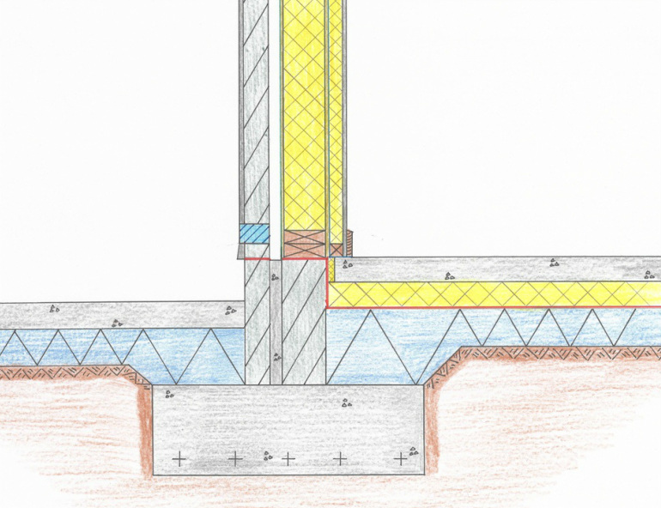
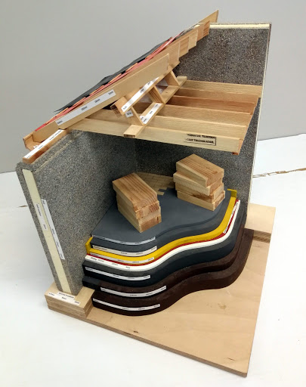
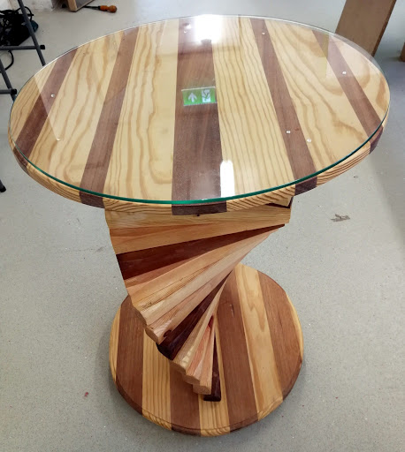
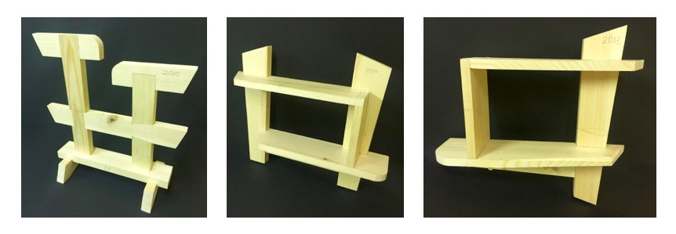
Sample of Student Work – Expectations
Drawing Details
Project Work
Practical Skills Work

Slide 28
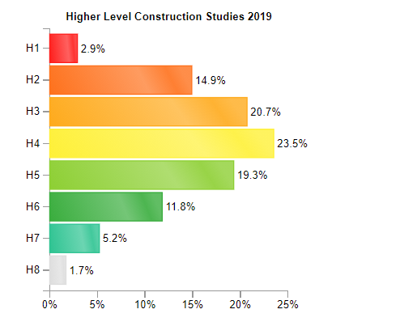
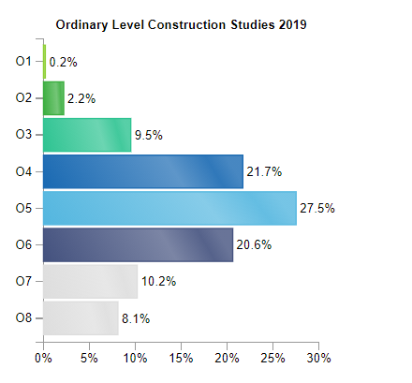
Student Achievements
Below you can see the grades awarded for Construction Studies in 2019 for both Higher and Ordinary level.

Slide 29


Potential Careers
This subject builds skills and knowledge that are particularly useful for careers in the Construction, Architecture and Property Sector. This includes the following careers:
Civil Engineering.
Skilled Trades – Carpenter, Electrician, Plumber, etc.
Construction Management & Planning.
Architecture.
Property Management and Auctioneering.
Quantity Surveying.

Slide 30

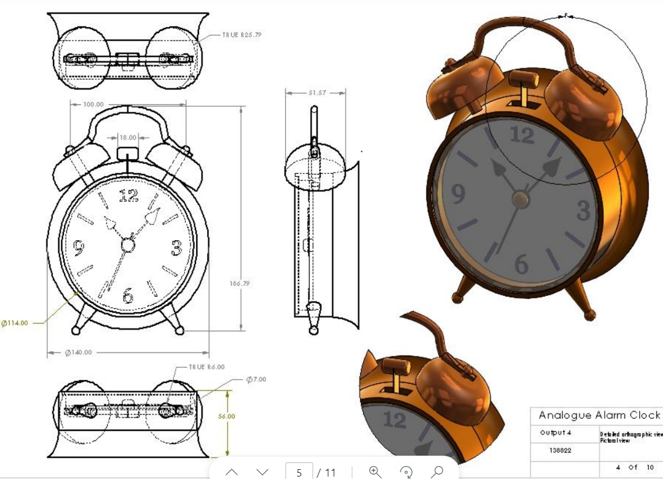
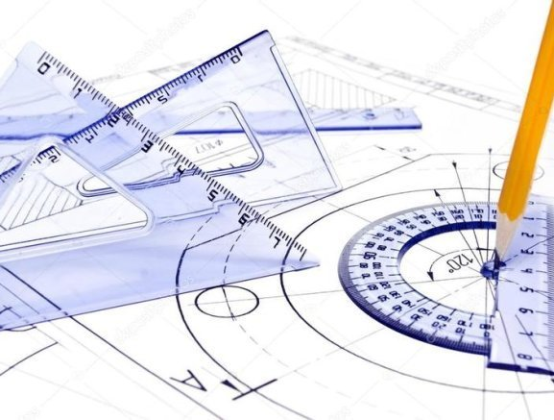
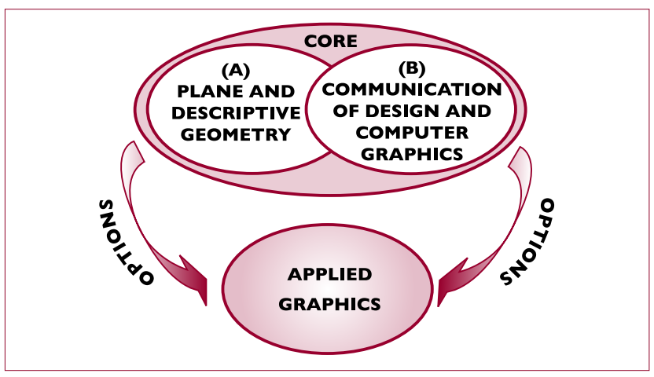
Design Communication Graphics (D.C.G)

Slide 31
Subject Overview
Leaving Certificate D.C.G provides students in senior cycle an introduction into the knowledge and skills involved in graphics. It dives into the world of communicating in a graphical way with a strong focus on design. It will help you develop your ability to design products and become innovative in problem solving. As well as communicating on paper they will also develop skills on the Solidworks CAD program to create products that you design accurately and aesthetically.
D.C.G is a continuation of Graphics at Junior Cert Level, but it is not essential to have done Graphics to take on DCG.

Slide 32
Structure of Subject
DCG students are encouraged to develop their visualisation and creative thinking skills through the analysis and evaluation of both 2D and 3D graphic problems. They will communicate this with freehand sketching, traditional draughting and with C.A.D (Computer Aided Design).
There are 2 main areas of study within the graphical communication areas- 1) Plane and descriptive Geometry
2) Applied Graphics
These areas are offered in Higher and Ordinary levels of the subject.

Slide 33
Assessment at Leaving Certificate
DCG is assessed at both Ordinary level and Higher level by means of:
A Board and Drawing Exam (60%).
A Design Project (40%).

Slide 34
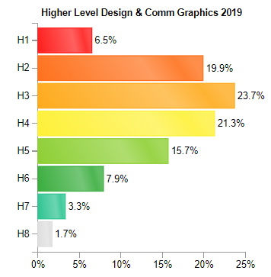
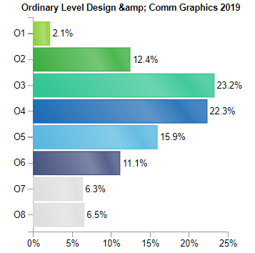
Student Achievements
Below you can see the grades awarded for D.C.G in 2019 for both Higher and Ordinary level.

Slide 35
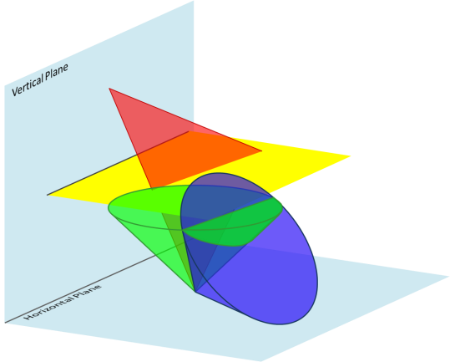
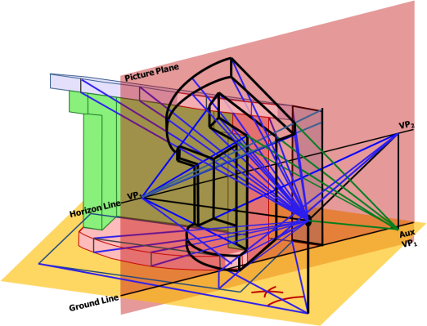
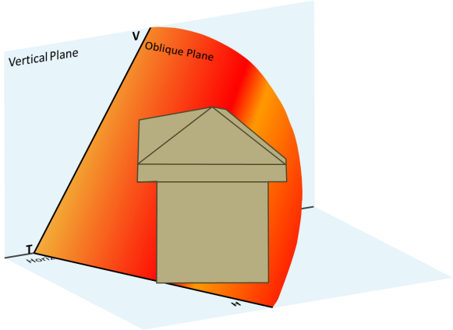
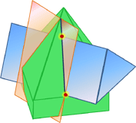
Assessment at Leaving Certificate
Part I - Drawing Exam (60%)- Students learn the Core topics in DCG. Students learn and practice this skill by drawing with a T-square, Board and setsquares etc... They will draw detailed solutions to the topics mentioned below. Learning the principles, axioms and theroms of each topic and will help them become very good problem solvers. These skills can carry over to other subjects like LC Engineering and Art where design is involved.
Interpenetration
Lamina and Skew Lines
Perspective Projection
The Oblique Plane

Slide 36
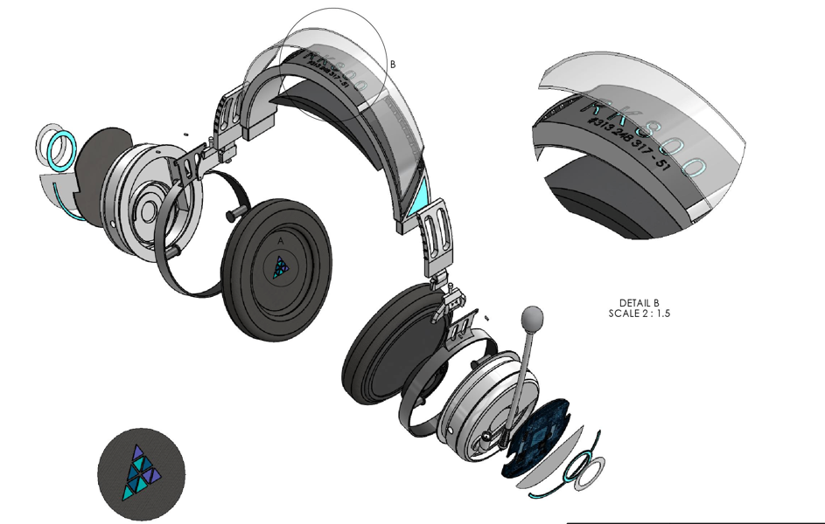
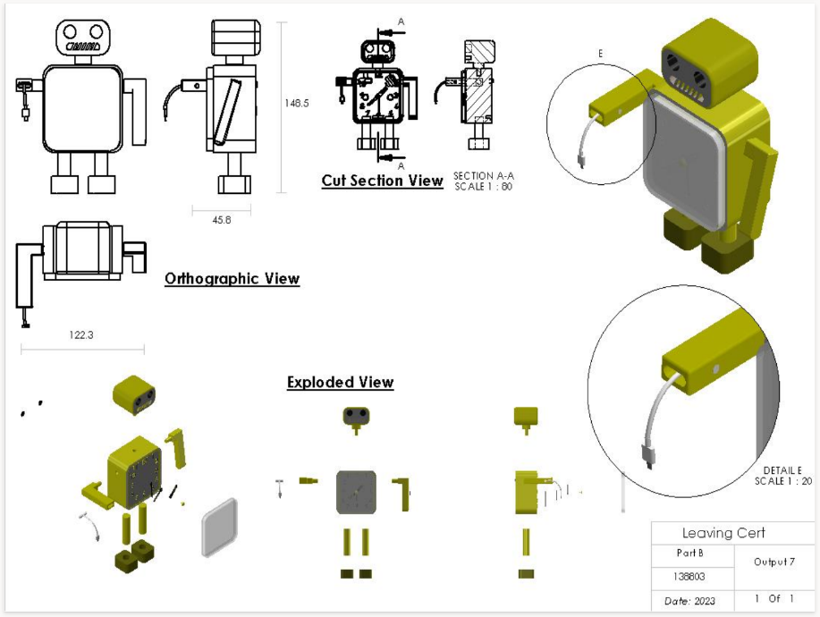
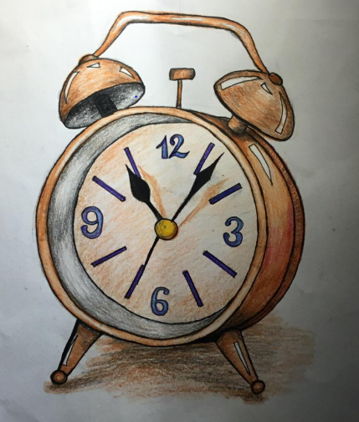
Assessment at Leaving Certificate
Part II – Project (40%)- In the 1st term of 6th year students will take on an individual design CAD based project. Here students will have to research an existing artefact design, present existing solutions in sketches and CAD and then create and present their own modified/new design. The student uses freehand sketching, graphic design and 3D modelling skills as modes of graphical communication to present their design solution. Each student must submit a 14 page A3 portfolio which shows their research, original sketches, detailed CAD drawings & Assemblies and .

Slide 37
Potential Careers
Graphic Design.
Architecture & Architectural Technician
Skilled Trades – Carpenter, Electrician, Plumber, etc.
Interior Design- Whole house, Fitted Kitchens/Cabinets/Wardrobes etc..
Construction Engineer, Civil Eng., Building Surveyor.
Engineering- Mechanical, Aeronautical, Automotive, Electrical,etc. .
Product Design.
Animation and Computer Generated Imagery CGI.
Manufacturing/ Automation/ Production design

Slide 38


Leaving Certificate Engineering

Slide 39
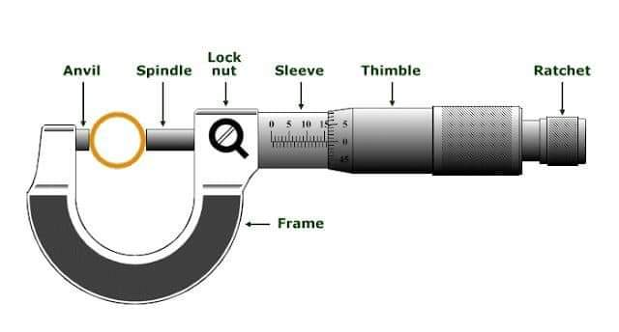
About Engineering at Leaving Certificate:
Leaving Certificate Engineering is the study of mechanical engineering. Students develop skills and initiative in the planning, development and realisation of technological projects in a safe manner. There are two main areas of study: workshop processes, and materials and technology.

Slide 40
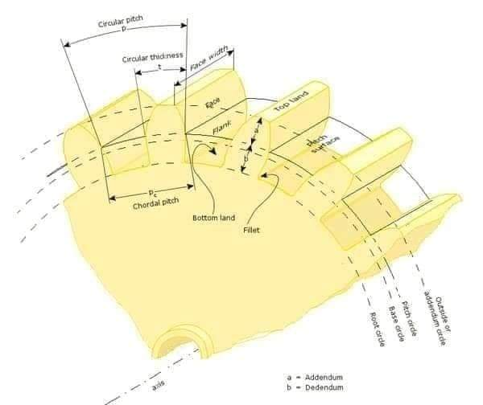
Why Study Engineering
Engineering gives students hands-on experience of working with hand tools and power tools. Students also undertake theoretical work for their final examinations which provides useful skills for those considering a career in the sector of any form of engineering.

Slide 41
What kind of Student would Engineering suit:
The subject follows on from Junior Cert Engineering. Ideal for anyone that has sat the subject at Junior Cert but
Each student should have an aptitude for and an interest in design and practical work.
Someone that enjoys creating and problem solving.
Someone that enjoys fixing things and understanding how different things work.

Slide 42
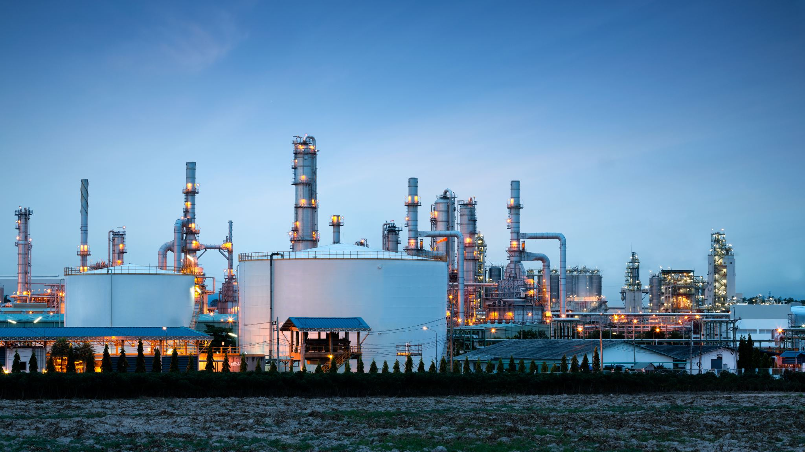
Possible Courses & Career Paths/ Apprenticeships:
3rd Level College courses:
  Engineering courses: Mechanical, electrical, chemical, Manufacture & Design, environmental & Biomedical.
  Architecture.
  Product design.
  Biomedical Sciences.
  Many more…..
  Apprenticeships/ Employment:
  Construction.
  Mechanic.
  panel beater.
  Welder.
  Plumber.
  aircraft technician.
  army/air corps
  Electrician.
  Many more…

Slide 43
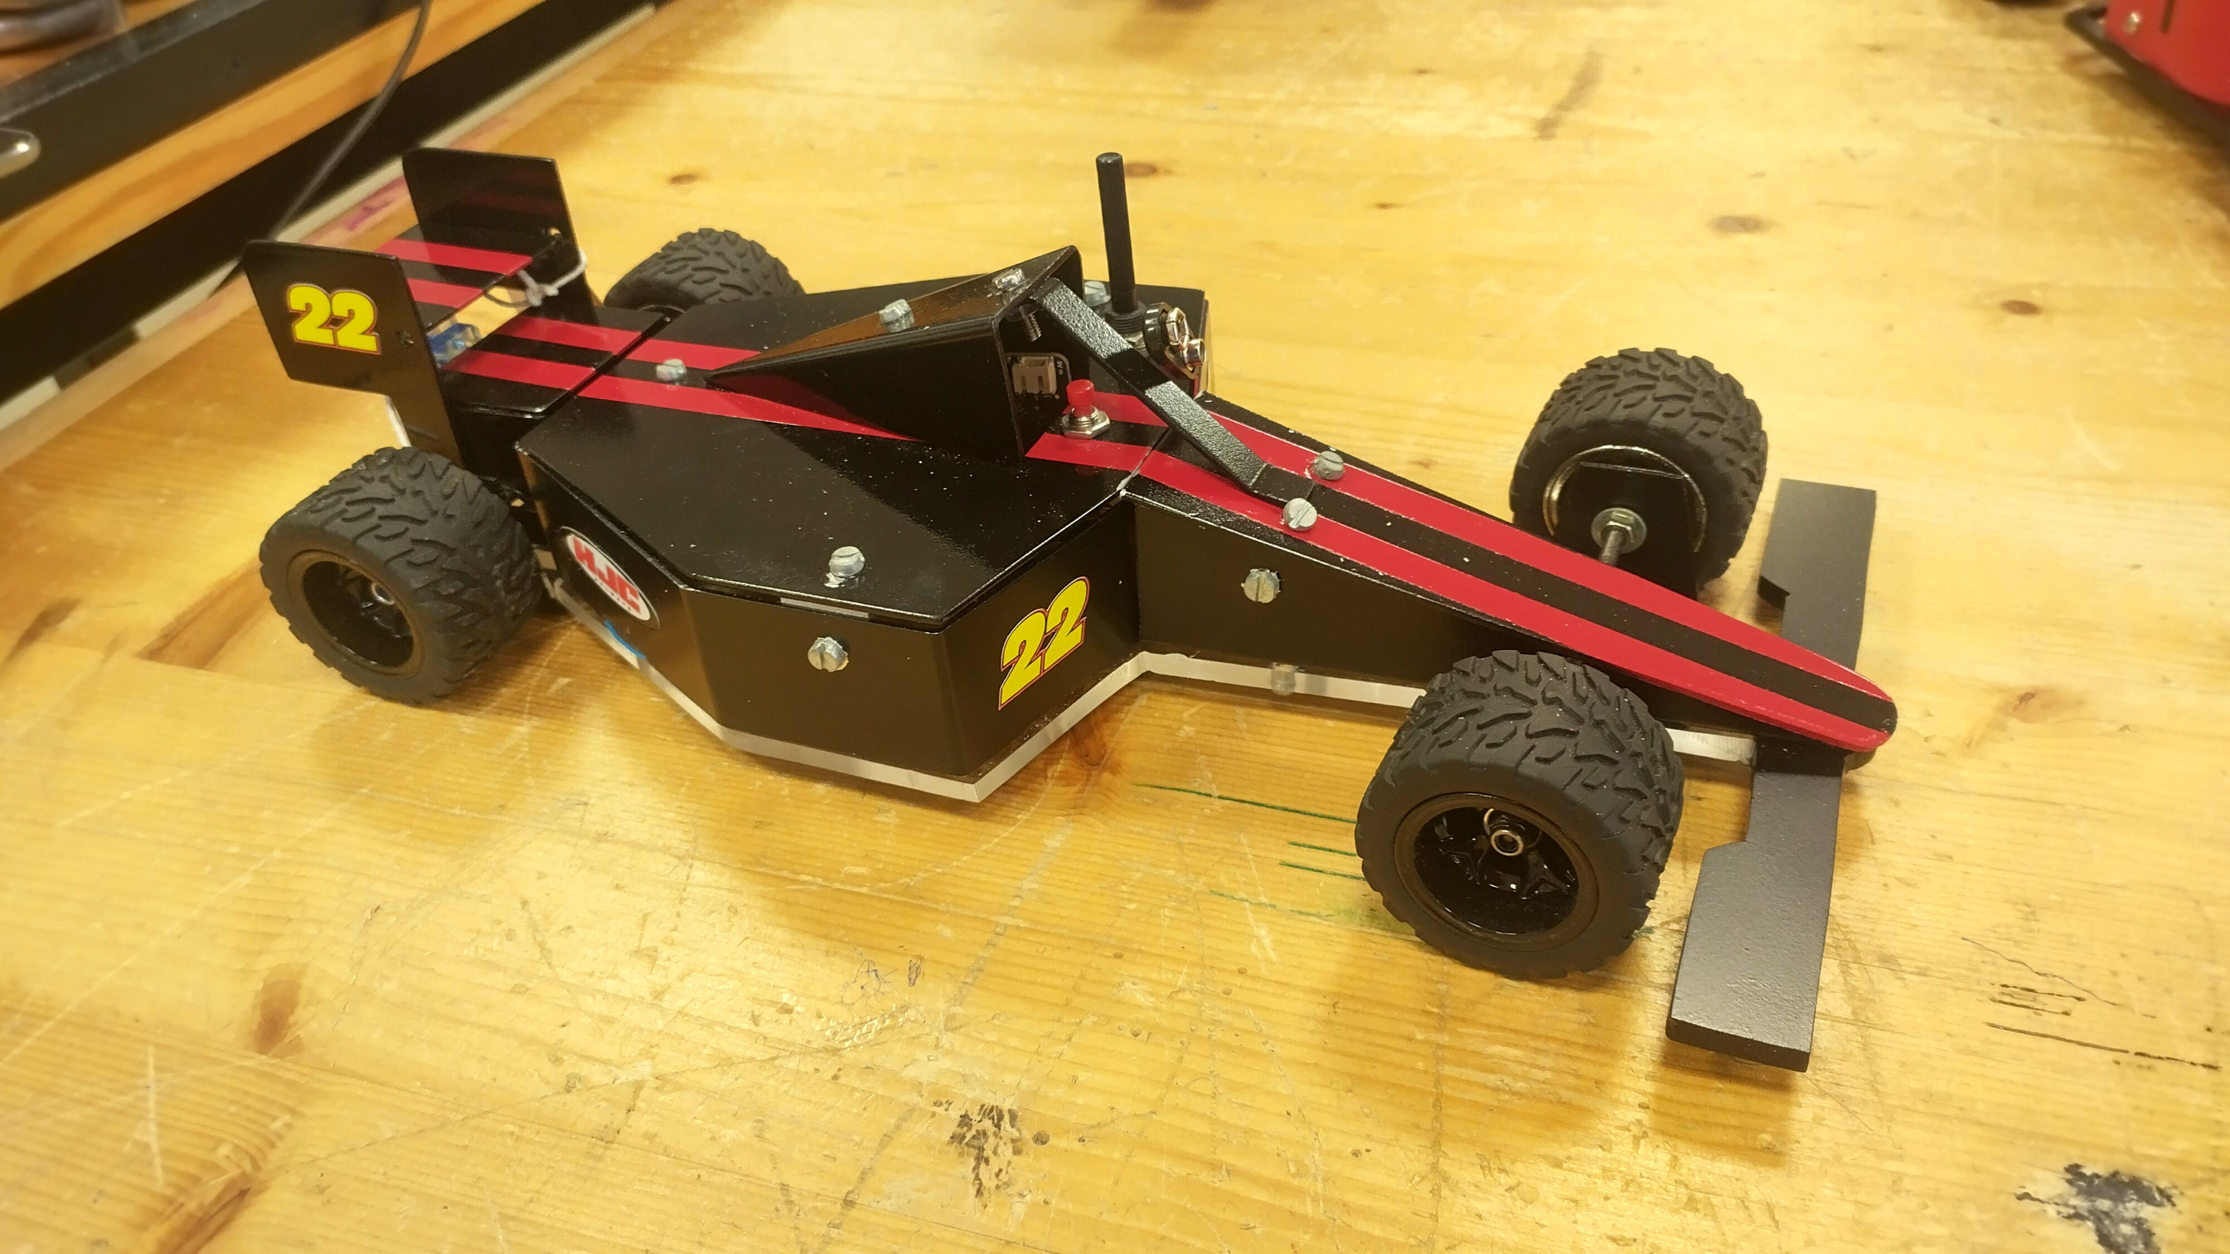
Assessment: 2 Practical & 1 Written element.
Practical Project: Students are required to submit a model and design folio based on the brief. This is worth 25% of the overall marks for Higher Level Engineering and 30% at Ordinary Level.
Day Practical: Students are given 6 hours to complete a small mechanism project. This takes place in schools in May. Students are required to show skills of drilling, machining and fitting and precision filing. This is worth 25% for Higher Level and 30% for Ordinary Level Engineering Students.
Written exam: Lasting 3 hours at Higher Level and 2.5 hours at Ordinary Level. This is worth 40% at Ordinary level and 50% at Higher level. The exam is made up of 8 questions, in which students must answer Question 1, and any other four questions from the remaining seven.

Slide 44
GEOGRAPHY
CORE UNIT-INCLUDES PHYSICAL& REGIONAL TOPICS, SKILLS BASED MATERIAL, FIELDWORK
ELECTIVE UNIT: HUMAN ENVIRONMENT OR ECONOMIC GEOGRAPHY
OPTION-HIGHER LEVEL GEOECOLOGY

Slide 45
Physical
Here we examine in more details some of the topics which you will have covered at Junior Cycle. These include:
• Plate tectonics
• Volcanoes/ Earthquakes
• Rocks
• Weathering/Erosion/Mass Movement
• Rivers, Coasts and Glaciation

Slide 46
Regional
Here we examine the world around us in more detail, locational geography
• Define what a region is
• Explore the types of regions - for example religious, regions defined by language
• The issues which might arise in those regions
• We also explore the economic activities in each region we study- so Primary, secondary and tertiary economic activity
• Look at if they are a core or peripheral region
• The Human processes of that region- Population structure, migration

Slide 47
Skills and Investigation
• Covers things like map work, direction, measuring and sketching skills
• Develop your skills to interpret the physical landscapes on an OS map
• Interpret the human and economic landscapes
• Graph and table reading and how to display information using those items
• These skills can transfer into many areas of work and even study in college
• They are also essential to the field work part of the course

Slide 48
Field Study/ Investigation
Accounts for 20% of your overall exam result.
Is conducted before the exam
Usually in 6th year
Involves day to site-using skills developed and practiced in class
Location-Killeagh Woods, East Cork (Fluvial/River investigation)

Slide 49
Elective Unit: Economic or Human
You will study either human or economic geography (this will be decided at a later date by the Geography Department in CCC
Human Geography: the study of people and places-eg population, migration, etc
Economic Geography: the study of commercial activities and the exploitation of resources for economic gain
Usually studied in 6th year

Slide 50
Option Unit: Geo Ecology
This unit is for higher level students only
This unit covers two main topics:
1) Soils
2) Biomes
This unit is studied in 6th year

Slide 51
Biomes
• Biomes are the various natural regions of the earth where climate, soils, vegetation and animal life are dependent on one another
• This unit is similar to the climate section you would have covered in geography before but now we focus specifically on some key examples
Focus on the Tropical Rainforest Biome
• We look at the different examples of tropical rain forest biomes across the world and focus on the Amazon rainforest.
We also look at the impact of human activity on the rainforest biome

Slide 52
Exam
• Exam is 80% of over all mark
• Field work is 20%
• Essay based- some short answer questions
• Higher and ordinary level papers differ
• Only difference in topics is higher level study geoecology and isostasy
• Not decided until 6th year- stay in same class

Slide 53
Home Economics :Social & Scientific
Subject Overview

Slide 54

Things you should know!
Social & Scientific is a wide ranging subject covering many life skills
There is both HL & OL within the subject
There are cross curricular links with Biology and Business
The subject builds skills & Knowledge that are particularly useful in the following Career sectors

Slide 55
Career prospects
Social Studies
Nursing
Teaching
Food & Culinary Industry (Chef)
Fashion, Design, Manufacturing and Merchandising
Hospitality, Tourism & Recreation. Irish Food Industry
Interior Design, Furnishing & Maintenance
Family & Human Services
Childcare
Food Science
Dietitian/Nutritionist

Slide 56
The Senior Cycle Syllabus provides students with knowledge, understanding, skills & attitudes necessary for managing:
1. Themselves in their own everyday lives
2.Themselves in Further Education & Work.
The course is a continuation of what was studied for Junior Cert but in more detail

Slide 57
What kind of student will Social & Scientific Suit ?
The subject suits a student who displays interest in :
Nutrition, Consumerism, family & social issues
Meal planning, cooking and getting value for money
Managing money & resources
Current affairs & social issues

Slide 58
Choosing Social & Scientific
It is advisable for students opting for Social & Sceintifc H.Ec. to have completed the Junior Cert Home Economics course.
Some of the areas studied are covered at Junior Cycle level are covered in more detail at Leaving Cert level
Much of the course is Theory based – “it is not all about cooking”
The practical side of the course has to be written & presented in a food journal format.
There is no practical exam at senior cycle level

Slide 59
Subject Content-Written Exam
Social & Scientific Home Economics consists of 3 core areas & 3 Elective Areas
Core Areas
1.Food Studies - 45%
2.Resource Management & Consumer Studies – 25%
3. Social Studies -10%
Electives (20%)
1.Home Design & Management
Or
*2.Textiles, Fashion & Design
Or
3. Social Studies
Students opt for one Elective area only.
*Those producing the Textile, Fashion & Design module must produce a garment which will be inspected & graded
The electives are extensions of the content contained in the Core Areas and provide students with the opportunity to study specific areas in more depth.

Slide 60
Exam Structure
The Leaving Certificate Home (Social & Scientific) revised syllabus is examined as follows:
Written exam Paper – 80%
The written examination consists of three sections
Section A
-12 Short Questions - Students answer 10. These deal mainly with all core areas of practice-mainly core 1 (60 marks allocated)
Section B
-5 questions - Students are to answer question 1 (Food & Nutrition) and any other 2 questions from core areas (180 marks allocated)
Section C
-3 Questions - Students to answers 1 question, based on elective chosen & studied in class (80 marks allocated)

Slide 61
Exam Structure Continued
* Practical Course work (Journal) – 20%
This takes the form of the Food journal, (this journal is submitted for marking in October of the leaving certificate examination year) . It is marked at a common level.

Slide 62

Leaving Certificate
Physical Education

Slide 63
Course Content
Strand 1: Towards Optimum Performance - Students learn about different theoretical perspectives that impact on optimum performance and how to apply this understanding to a range of different activities.
Strand 2: Contemporary Issues in Physical Education - Students learn about contemporary issues in physical activity and how different people experience physical activity and sport.
A variety of tools will be used, including video and photography, to analyse your own and others’ performance.

Slide 64
Subject Requirements
Active participation is vital in LCPE. As you learn about various theoretical perspectives you have the opportunity to put them into practice in a practical setting.
Interest in the biomechanics of human movement and how the body responds to, performs during, and recovers following physical activity.
Good organisational skills. There is a lot of self-directed work, particularly when it comes to the PAP in 6th year.
A genuine interest in how different groups experience and access physical activity and sport.
The ability to work well independently and as part of a group.

Slide 65
ACTIVITY
AREAS
STUDENTS STUDY ONE ACTIVITY FROM 3 OF THESE 6 AREAS
GAMES
PERSONAL EXERCISE & FITNESS
ATHLETICS
AQUATICS
ADVENTURE ACTIVITIES
AESTHETIC & ARTISTIC ACTIVITIES

Slide 66
STRAND 1 – TOWARDS OPTIMUM PERFORMANCE
STRAND 1 consists of 4 topics – all of which must be studied by students. The 4 topics are:
1. Learning and improving skill and technique
2. Physical and psychological demands of performance
3. Structures, strategies, roles and conventions
4. Planning for optimum performance

Slide 67
STRAND 2 – CONTEMPORARY ISSUES IN PHYSICAL ACTIVITY
Strand 2 consists of 6 topics. Topics 5 & 6 must be studied:
5. Promoting physical activity
6. Ethics and fair play
In addition, two of the following topics will be prescribed by the DES for study:
7. Physical activity and inclusion
8. Technology, media and sport
9. Gender and physical activity
10. Business and enterprise in physical activity and sport

Slide 68
How is LCPE assessed?
20%
Physical activity project H&O – Students analyse their performance in a specific activity, set performance goals, create and follow an improvement plan, and reflect on performance.
30%
Performance assessment. Common level – one of the three activities studied in class must be used. Performance is captured digitally to display student’s best Performance in the chosen activity area.
50%
Written examination H&O - The exam consists of short questions, a case study and long questions.
Submitted before Christmas in 6th year
Submitted before Easter in 6th year
Completed in June with other State Exams

Slide 69
Career Opportunities
Sports Science
Leisure and Recreation Management
Physical Education Teaching
Physiotherapy
Physical Therapy
Personal Training
Etc.

Slide 70

Leaving Certificate 2026
Music

Slide 71
Leaving Cert Music - 3 main elements
      Performing & Technology
      Composing
      Listening
Choose one of 3 main elements as 50%

Slide 72
Exam Structure
Higher and Ordinary Level
Listening paper- 1.5 hours (25%)– examined in June
  6 questions
Composing paper – 1.5 hours (25%)
  2 questions
Performance/technology – practical exam in March/April of leaving cert year – (50%)

Slide 73
Basic Requirements
An interest in music theory, performance and composition
Junior Cycle Music is an advantage but not a prerequisite.
Basic music theory – notation, rhythm, music vocab, the orchestra, music history & eras.
Some performance experience an advantage (in school or outside)
  Voice, instrument or technology
Examined at the level of 5 years classroom-based experience
Students do not have to study an instrument outside of school to take leaving cert music

Slide 74
Subject Content
Analysis of 4 orchestral works.
  Beatles
  Mozart
  Berlioz
  Deane
Irish Traditional Music listening & essay question
Aural Studies
Melody writing
Backing Chords

Slide 75
PHYSICS
Subject Content
The Physics course involves a lot of theory which is tested in the written examination. Students are expected to be able to use various formulae with respect to SI units and significant figures and have a good understanding of the role of physics in modern society and technology. The course also consists of 24 core mandatory experiments complementing each section in an aim to develop students’ technical skills and enhance understanding and reinforce key concepts.
The study of Physics for Leaving Certificate is broken down into eight sections or topic areas:
  (a) Six compulsory sections (b) Two option sections (Higher paper only, one to be done)
Compulsory sections
  Optics / Waves: the study of light and sound and real-life applications of the theory.
  Mechanics: time, space, distance, speed and acceleration.
  Heat: changes of state, energy conversions and mathematical problems.
  Electricity: develops on from simple circuits to more detailed concepts.
  Electricity and Magnetism: gravity, relationship between electricity and magnetism, study of how a motor works, ac. and dc. circuits and phenomena with real world applications.
  Atomic Physics: cathode rays, x-rays, radioactive decay, fission and fusion, nuclear reactors and real world applications.
Options: Particle Physics OR Applied Electricity

Slide 76
Exam Structure
Leaving Certificate Physics is assessed by means of one terminal examination paper at each level. Students are required to keep a record of their practical work over the two years of the course.
The leaving cert exam is three hours in duration. A total of 400 marks are available for the exam.
Section A:
Students must answer 3 out of 4 questions; 120 marks: 40 marks per question
Questions are based on experimental procedures and use of results
Section B:
Students must answer 5 out of 8 questions; 280 marks: 56 marks per question
Questions are broader and theory based

Slide 77
Basic Requirements
While there is an element of maths in the physics course, honours maths is not a requirement to do honours physics. Students should not avoid physics on the basis of not having honours maths. It is entirely possible to get on well in honours physics without honours maths.
Pupils should become capable at drawing and reading graphs and competent in using a calculator through the course.
The physics syllabus has strong links with the other science subjects, especially chemistry. There are strands of physics which overlap with woodwork and construction, especially the electricity and heat sections.
Pupils who will gain the most from studying physics are those who have an interest in science at Junior Cert level and those who enjoy learning about how things work.
Career prospects
Students who are interested in the following careers would be advised to study Physics: Electrician, Optician, Doctor, Dentist, Engineer, Computer Technician, Physics Teacher and Programmer.
Physics is a useful subject for many courses and career areas and a good foundation for a broad range of scientific and technical careers.
Many careers benefit from the logical and numeracy skills developed in the study of physics. Many technical courses involve components of physics.

Slide 78
Politics and Society
Subject Content:
  All students study four key units:
    Power and Decision Making
      In school
      At a national and European level
    Active Citizenship
      Communities, and Rights and Responsibilities
    Human Rights and Responsibilities
      In Ireland
      Around the world
    Globalisation and localisation
      Identity and Sustainable Development

Slide 79
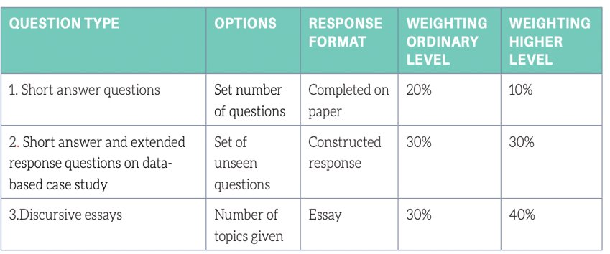
Politics and Society
Exam Structure:
The Politics and Society course can be studied at higher and ordinary level.
The course is assessed in two parts:
A citizenship research project worth 20%.
  Students each choose a project title from a list provided by the Department of Education in 5th year.
A written exam worth 80%. The exam consists of:
  Short answer questions (worth
  Questions on a data-based case study
  Discursive essays

Slide 80
Politics and Society
Basic Requirements
Career Prospects
  An interest in areas such as human rights, equality, diversity, inclusion, sustainability, development, power and democratic decision making
  An interest in CSPE at Junior Cycle level
  Enjoy formulating opinions on global issues
  Participation in discussions and debates
  An interest in keeping up with current political events
  Critical thinking skills
  Politics
  Journalism
  Teaching
  Government
  Activist
  NGO work
  Charity Sector
  Media Studies
  Anthropology
  Sociology
  Law
  Philosophy

Slide 81
VISUAL ART
Subject Content
Visual Studies ( formally known as Art history and appreciation)
Visual Art (formally known as Art, Craft and Design)
Exam Structure
Marks are broken down into three components worth 450.
300 marks = 12 weeks on workbook with given theme to produce two finished pieces a 2D and a 3D.
One piece must be finished in a 5 hour invigilated exam.
Artefacts produced must be different areas of practice
150 marks = Art history and appreciation (Visual Studies) the exam consists of 2 long essay questions and 5 short questions on general Visual Art.

Slide 82
Basic Requirements
An understanding of art elements and design principles.
An interest and understanding of the artistic process and visual culture.
Visual communication skills and good observational drawing skills.
A good understanding of self-directed work.
Junior Certificate Visual Art is not an essential requirement for senior cycle but will help your overall understanding of the artistic process. .

Slide 83
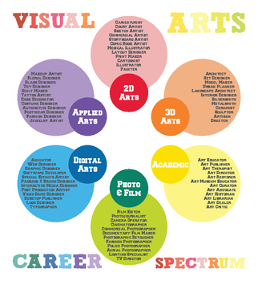

Slide 84
history
Subject Content
Two topics from Irish history.
Two topics from the history of Europe and the wider world.
A focus on key concepts and key personalities in each of these topics.
One of these topics will be studied through a particular focus on documents.
Prior to the exam, you will also submit a Research Study that you undertake on a topic that is of particular interest to you.
Exam Structure
Research Study submitted prior to the exam. (20%)
Terminal exam (80%)
  Question 1: Documents questions and a related short contextualisation essay.
  Question 2: Essay
  Question 3: Essay
  Question 4: Essay
  The exam is 2 hrs 50 min. All questions are worth equal marks and there is an element of choice within each topic.

Slide 85
Basic Requirements
Strong English language skills.
Good organisation and planning skills.
A genuine interest in history.
An ability to engage in self-directed learning in a research project.
Willingness to commit a lot of time and effort.
Career prospects
Education – primary, post-primary and third level.
Tourism, hospitality and heritage.
Media, publishing and journalism.
Legal careers, security, defence and law enforcement.
Sales, retail and purchasing.
Human Resources.
Community and voluntary work.
Healthcare.
Government administration, international relations and foreign affairs.
Business management, marketing, banking and finance.
Information Technology.

Slide 86
BUSINESS
Subject Content
3 broad areas:
  People in Business
  Enterprise
  The Business Environment
7 units
  People in business
  Enterprise
  Management 1
  Management 2
  Business in Action
  Domestic Environment
  International Environment

Slide 87
Exam Structure
3 hour exam
400 marks
3 Sections:
  Section 1: Short Questions – worth 20% of overall exam
  Section 2: Applied Business Question [ABQ] – worth 20% of overall exam
    3 Q’s from 3 selected units, i.e. Units 4, 5 & 6 for examination 2022
  Section 3: Long Questions – worth 60% of overall exam
BASIC REQUIREMENTS
No waffle, no essays
Structured answers: Bullet points using SER – State, Explain, Relate
Time Management
Suited to those who are willing to work hard and caters for all abilities
Junior Certificate Business Studies is not a requirement, but this would be a help

Slide 88
Course content is factual and requires a lot of learning, containing only a few mathematical elements
Ideally, students would have an interest in business and current affairs and would have an up to date knowledge of economic environment
An organised and consistent attitude to homework and study are essential in this subject
Chief Examiners Report: Candidates who performed well had a detailed knowledge of business theory and showed a clear understanding of its significance, in the specific context of the questions asked. Candidates who performed less well on the Higher Level paper tended to do so because they had not engaged fully with the questions asked, failed to read the questions carefully, and their answers lacked structure or appropriate development.
Career prospects
Business is beneficial for candidates who might be interested in courses or careers in the area of:
  Finance, Enterprise, Economics, Commerce, Business Information Systems, Food Marketing & Entrepreneurship, Law, Government and Political Science, International Development
Careers:
  Advertising, Marketing & Public Relations, Clerical & Admin Roles, Banking & Financial Services Jobs, Tourism & Hospitality, Leisure, Sport & Fitness, Business Analyst/Consultancy, Fashion & Beauty, Law & Legal, Business Management & Human Resources

Slide 89
ECONOMICS
Subject Content
This subject is concerned with understanding the workings of a modern economy from both Macro and Micro level. The new Leaving Certificate Economics specification is presented in five strands that reflect five fundamental economic questions.
What is Economics About?
How are economics decisions made?
What can markets do?
What is the relationship between policy and economics performance?
How is the economy influenced by international economics?
Each strand is then broken down into a maximum of five sub-topics (see New LC Specification)
Exam Structure
There are two assessment components at each level:
written examination (80%)
research study (20%) – Newly introduced

Slide 90
Basic Requirements
Junior Certificate Business Studies is not a requirement, but this would be a help
Course content is factual and requires a lot of learning, Does contains mathematical elements – Charts, projecting economic performance, graphing supply and demand curves etc.
Ideally students would have an interest in business and current affairs and would have an up to date knowledge of the economic environment
Career prospects
The Leaving Cert economics programme can be an advantage for students considering third level courses with an economics element to course content. It can be useful for careers in:
Banking
Insurance
Finance
Marketing
Politics
Journalism
Current Affairs
All aspects of Business

